Slide 1
Correlates to level of consciousness
Supplement Report

Slide 2
Introduction to “indices” of consciousness
This section is prepared for myself (I am still new to neuroscience).
Indices that is associated with the degree of consciousness.
I start to have a sense of the "indices" of consciousness.
PCI (Thibaut et.al, 2015) is considered to be related to the level of consciousness. For example, higher values usually indicates higher level of consciousness.
wSMI (king et.al, 2013) is another paper I read in the summer. Similar to PCI.
Spectral exponent (Colombo et.al, 2019)
Epsilon machine (Muñoz et. al, 2019) statistical complexity may connect to level of conscious arousal. At least, this has been tested in flies.

Slide 3
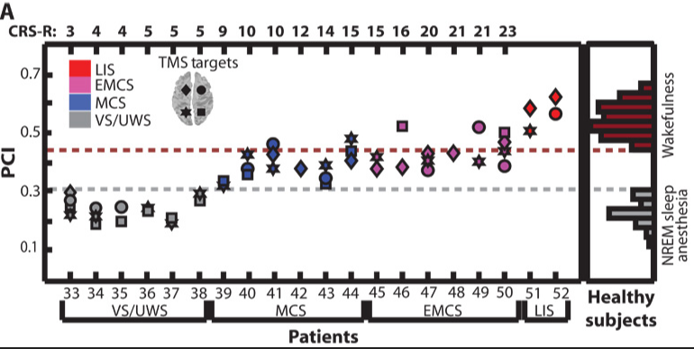
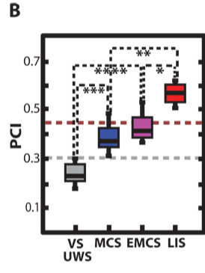
Perturbational Complexity Index (PCI)
VS : vegetative
MCS : minimally conscious
CS : conscious
H : healthy
https://www.researchgate.net/figure/Testing-the-Perturbational-Complexity-Index-PCI-A-PCI-values-are-shown-for-152-TMS_fig4_259631006

Slide 4
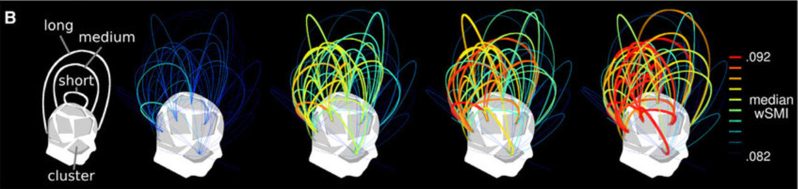
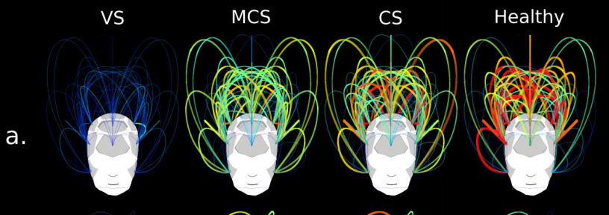
weighted Symbolic Mutual Information (wSMI)
VS : vegetative
MCS : minimally conscious
CS : conscious
H : healthy
https://www-sciencedirect-com.ezproxy.lib.monash.edu.au/science/article/pii/S0960982213009366

Slide 5
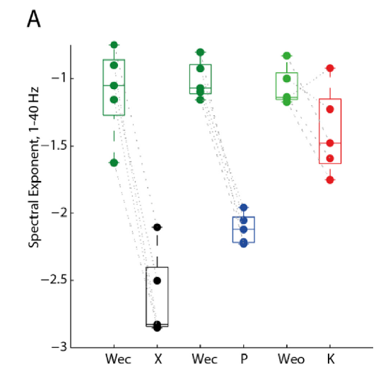
Spectral Exponent of the Resting EEG
Wec : wake, eye closed
X : xenon
Weo : wake, eye open
P : propofol
K : ketamine
(Xenon and propofol result in deeper anesthesia if their claims are not wrong)
https://www-sciencedirect-com.ezproxy.lib.monash.edu.au/science/article/pii/S1053811919300242?via%3Dihub

Slide 6
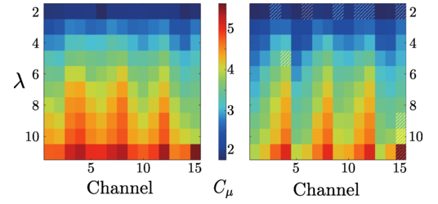
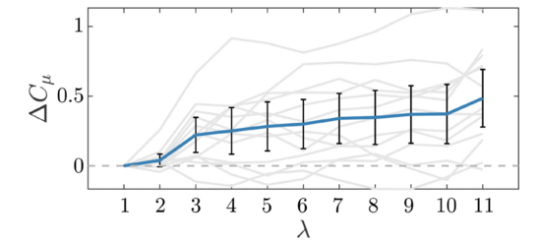
Statistical Complexities and Epsilon Machine
Statistical complexities decrease during anesthesia?
https://journals.aps.org/prresearch/abstract/10.1103/PhysRevResearch.2.023219

